Slide 1
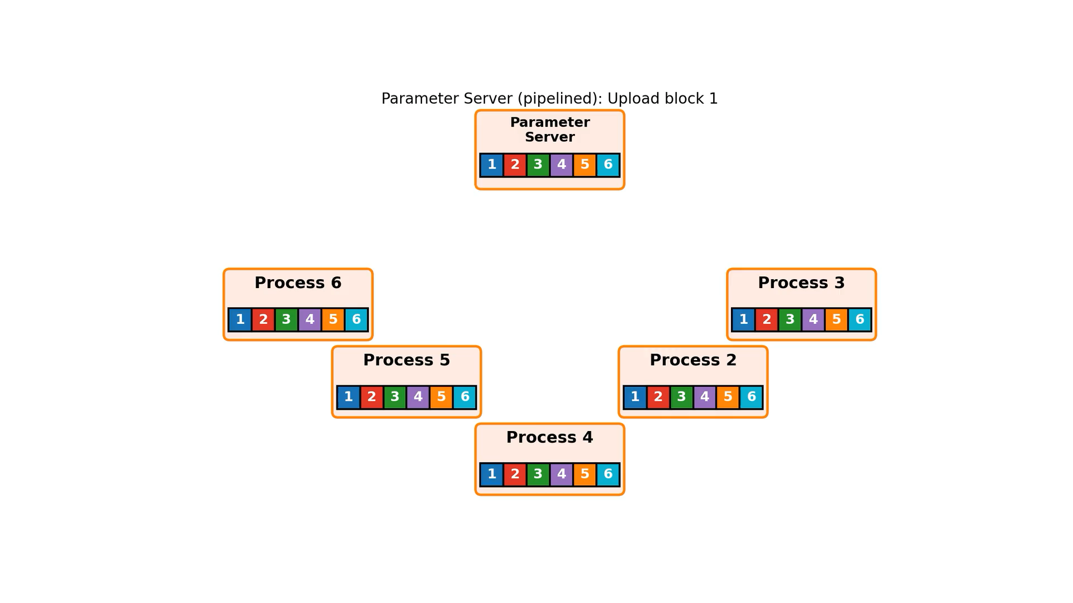
All-Reduce (parameter server)
Each process sends all the data at 1/n^{th} rate, then receives all the data at 1/n^{th} rate.

Slide 2
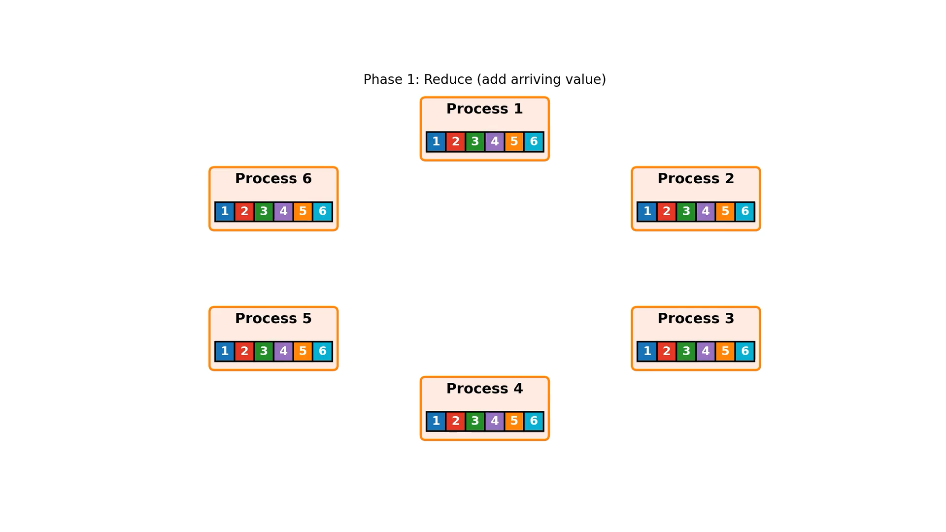
Ring All-Reduce (NCCL)

Slide 3
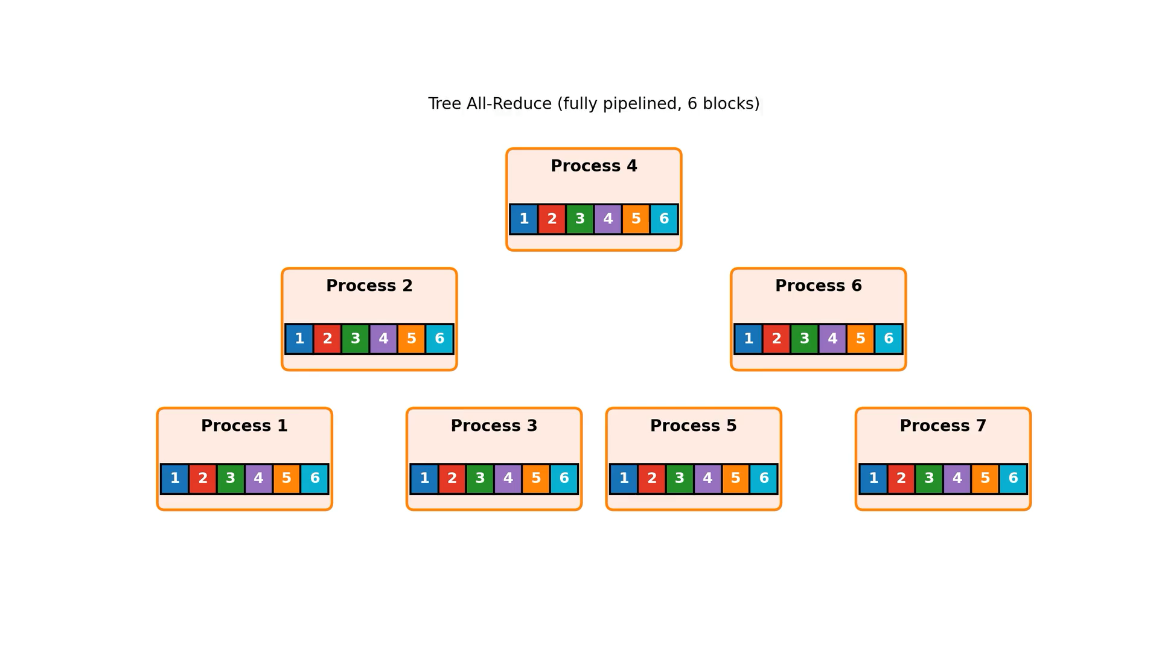
Tree All-Reduce (pipelined)
Good latency:
O(log(n)) stages
Good numerics

Slide 4
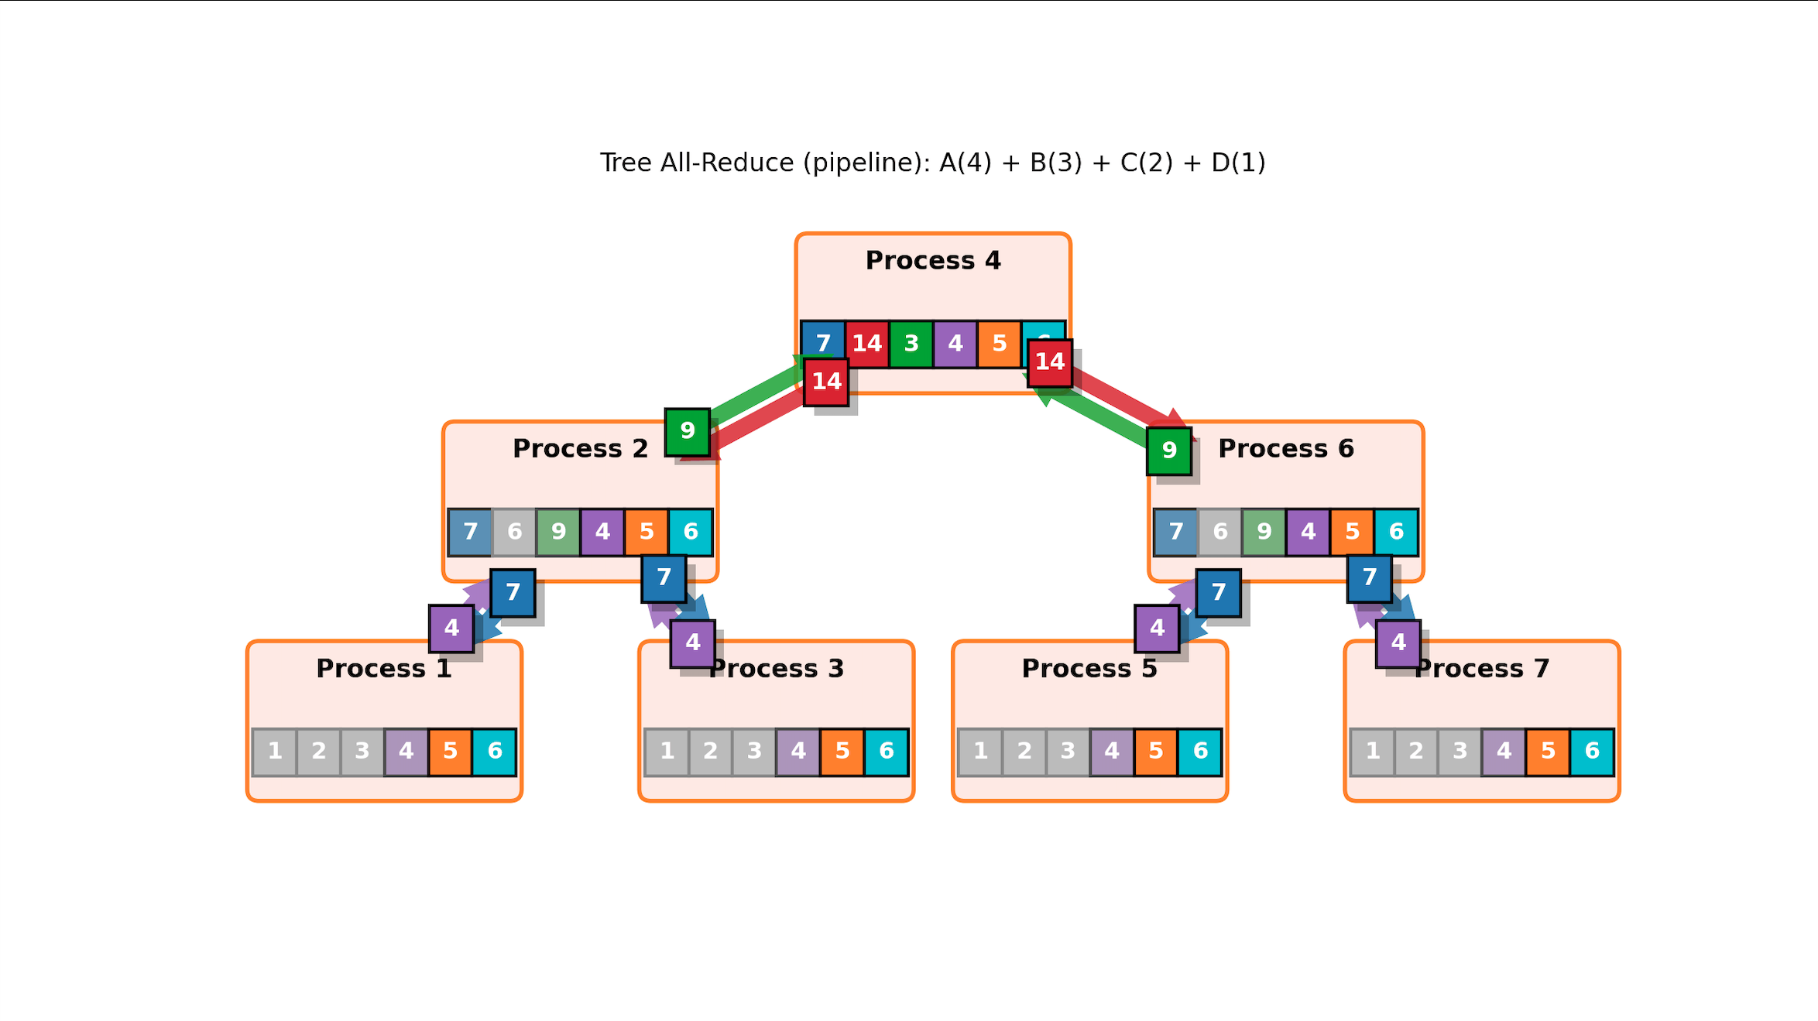
Tree All-Reduce
interior node:
send to three nodes, each at 1/3 rate
receive from three nodes, each at 1/3 rate
leaf node:
send to one node , 1/3 rate
receive from one node, 1/3 rate

Slide 5
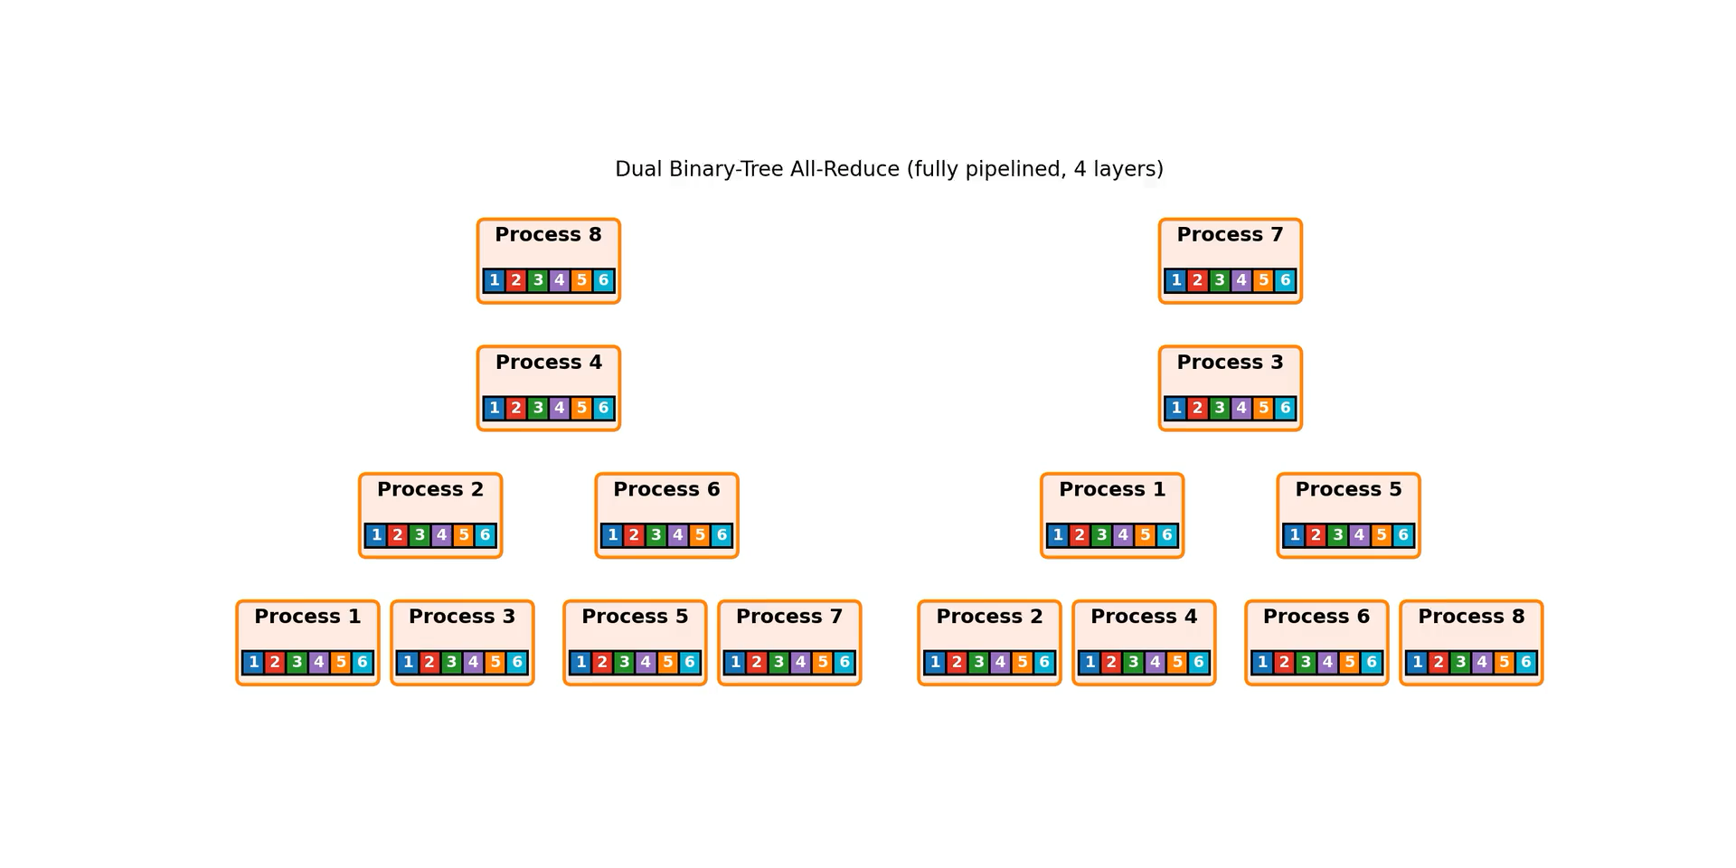
Dual Binary Tree

Slide 6
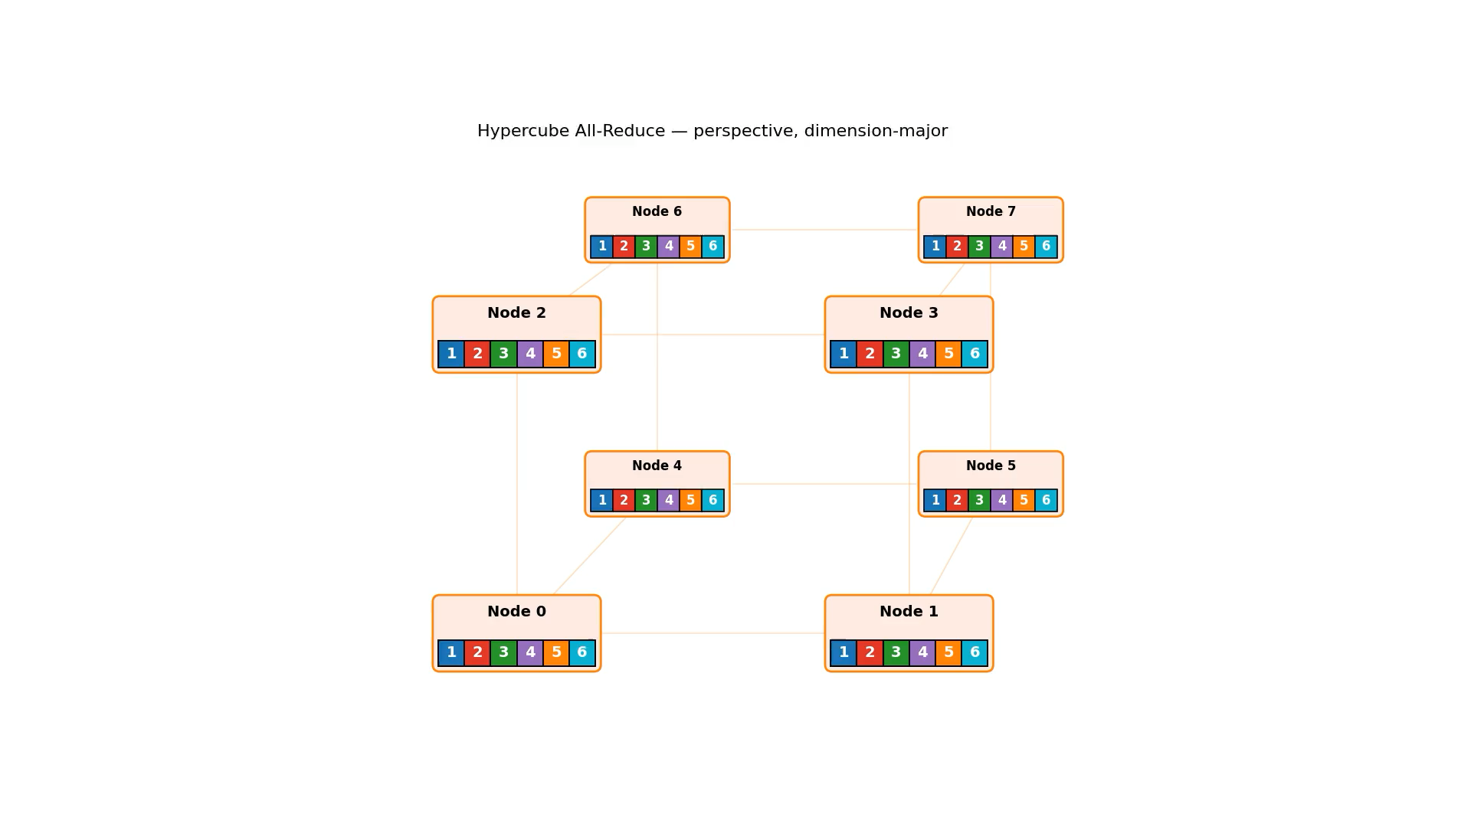
All-reduce (hypercube)

Slide 7
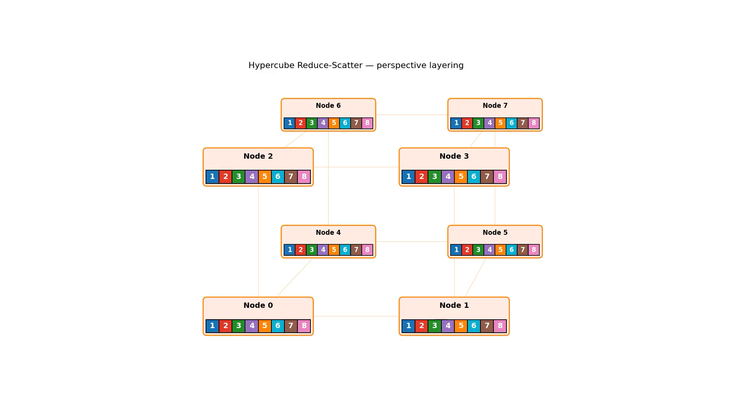
Reduce-scatter (hypercube)

